Slide 1
EE207
Electronic Devices and Circuits
S. Lodha
Q. Mech and Energy band theory
Supplementary Slides
Acknowledgements:
Advanced Semiconductor Fundamentals, R. Pierret, Purdue University

Slide 2
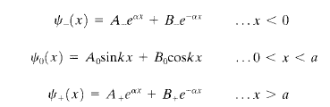
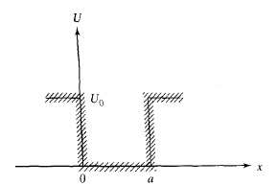
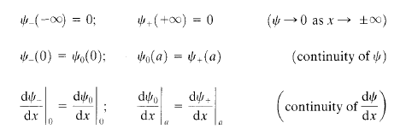
Finite potential well
Solve TISE in the three regions, x<0, 0<x<a, x>a with appropriate boundary conditions
17/01/18
S. Lodha

Slide 3
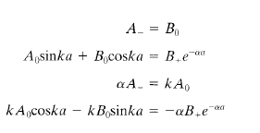
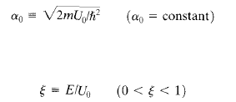




Finite potential well (contd.)
Four simultaneous eqns
Non-closed form solution for E
17/01/18
S. Lodha

Slide 4
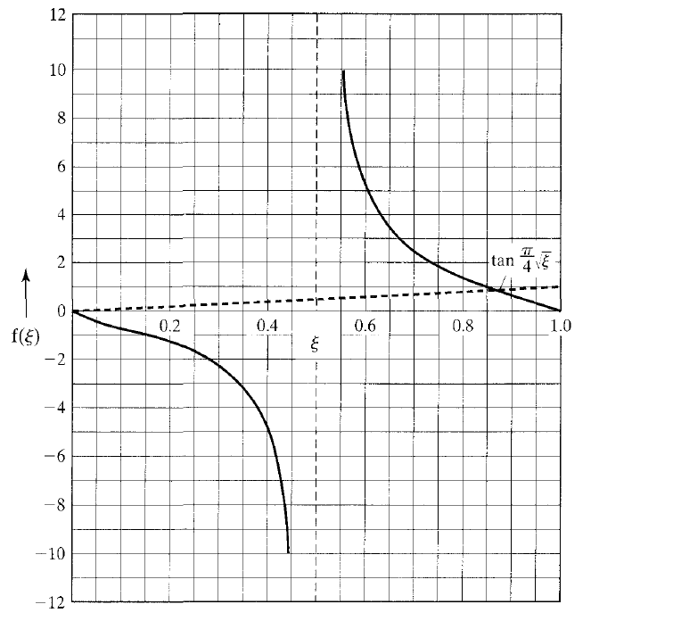
Graphical solution
Shallow well (α₀a<π → ) has only one solution of E=0.87U₀
Similarly, π<α₀a<2π has two solutions, and so on
17/01/18
S. Lodha

Slide 5
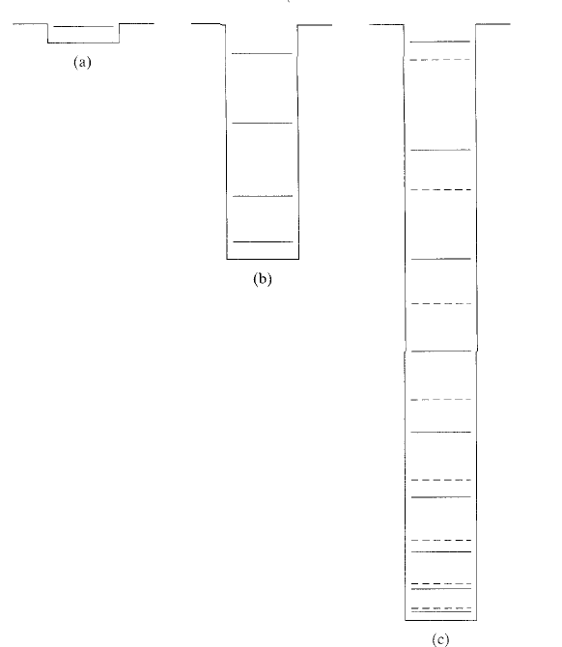
Finite potential well solution
1
2
En (finite) < En (infinite)
Deeper wells have increasing number of energy levels
17/01/18
S. Lodha

Slide 6

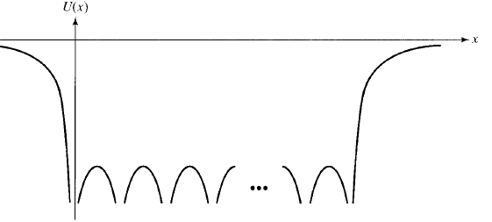
Electrons in a crystal
Perfect crystal (no defects, no impurities)
Periodic potential
17/01/18
S. Lodha

Slide 7
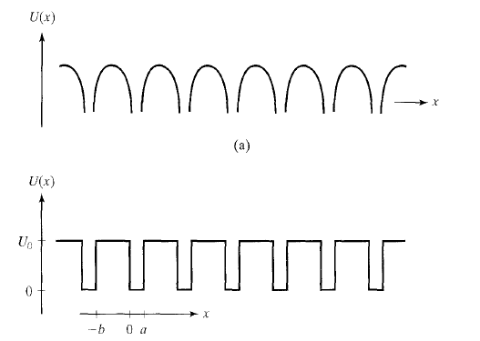
Kronig-Penney Model
-b<x<a is a unit cell repeated periodically
17/01/18
S. Lodha

Slide 8

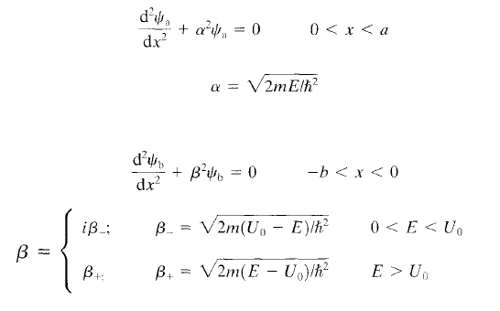
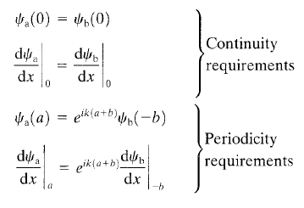
Kronig-Penney Soln
Setup TISE in the two regions
Setup boundary conditions based on continuity and periodicity (Bloch’s theorem)
17/01/18
S. Lodha

Slide 9
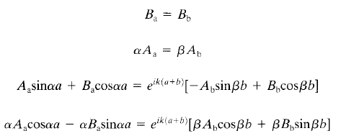
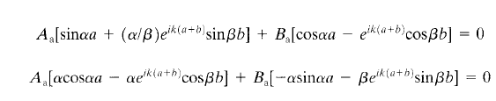
Kronig-Penney Soln (contd.)
Four simultaneous equations
n-homogenous eqns in n-unknowns will have a non-trivial soln if the determinant=0
17/01/18
S. Lodha

Slide 10




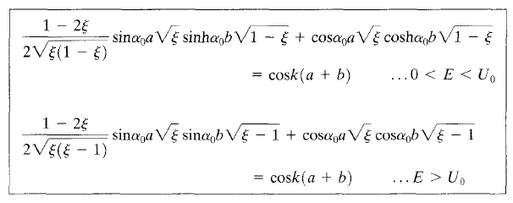
Kronig-Penney Soln (contd.)
Using
Defining
Such that
LHS is f(E) and RHS is f(k)
17/01/18
S. Lodha

Slide 11
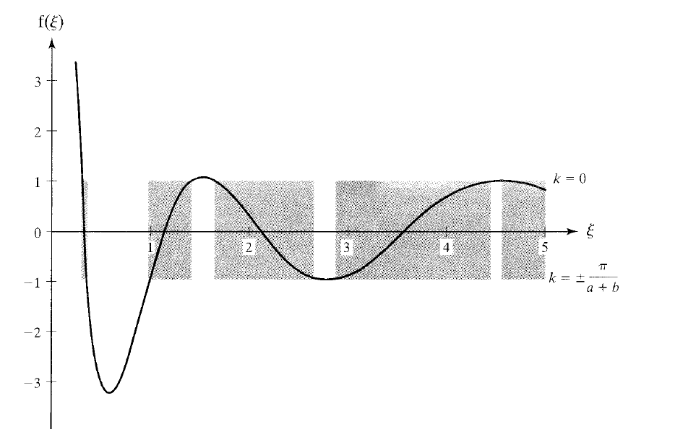
Kronig-Penney solution
Energy bands
Energy gaps
Assuming a=b, α₀a=π
Energies (ξ) for which f(ξ) lies between -1 and +1 are allowed energies
  Allowed energy bands and band gaps
17/01/18
S. Lodha

Slide 12
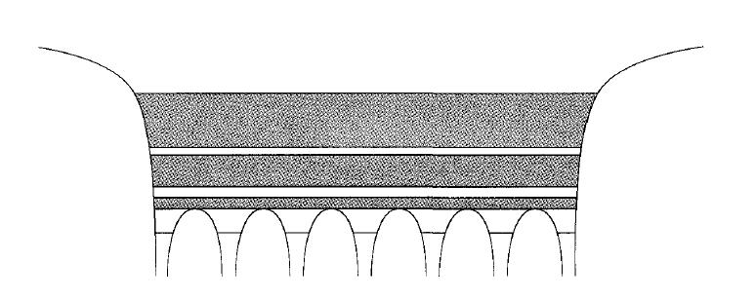
Relative to crystal potential
Energy bands and gaps relative to the crystal potential
17/01/18
S. Lodha

Slide 13
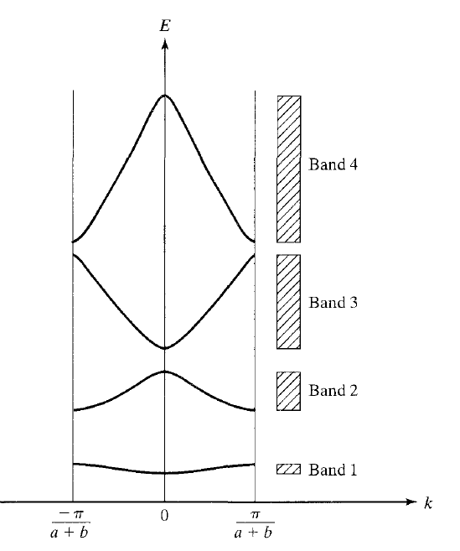
Reduced zone E-k diagram
Allowed k values in the range of 2π/(a+b)
  All unique E-k solutions
  dE/dk=0 at k=0 and cell boundaries
    True for real crystals also
17/01/18
S. Lodha

Slide 14
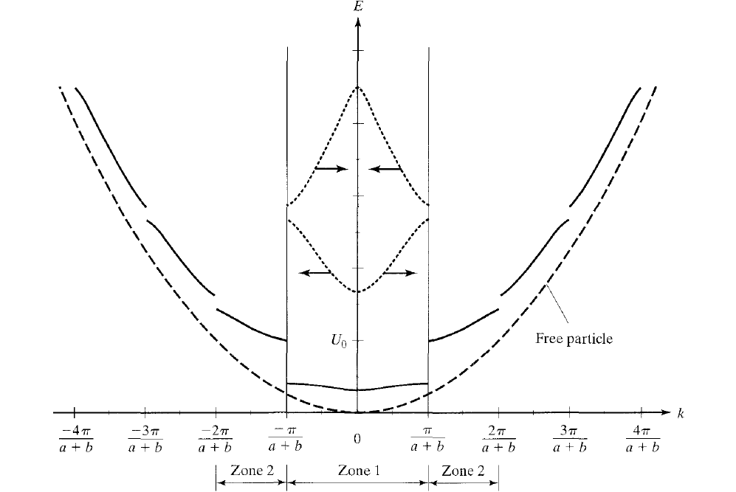
Extended zone E-k diagram
Free particle perturbed by crystal potential
Different Brillouin zones
17/01/18
S. Lodha

Slide 15
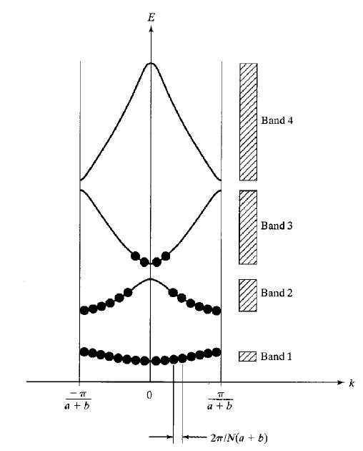
Concept of holes
1 D crystal of length L, N atoms, 2 electrons per atom
Under equilibrium net current=0
17/01/18
S. Lodha

Slide 16
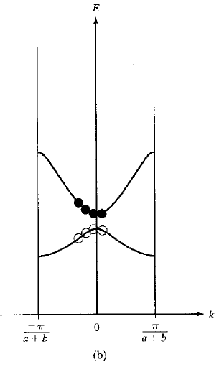
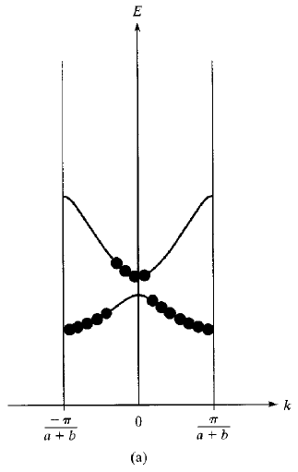



Applied Electric Field
Empty states (holes) with +q charge and m* is negative of the electron effective mass
m* is positive on top of bands
17/01/18
S. Lodha

Slide 17
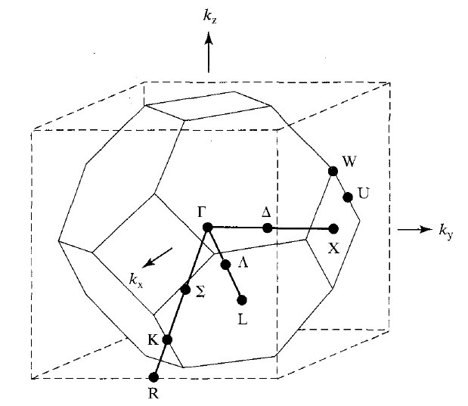
3-D Band Theory
Г identifies zone center (k=0)
X shows zone end along <100> direction
L shows zone end along <111> direction
Brillouin zone is a volume, k is a 3-d vector
First zone for materials in diamond (Si, Ge) or zinc blende (GaAs) lattice
  octahedron truncated at {100} planes 2π/a from zone center (k=0)
17/01/18
S. Lodha

Slide 18
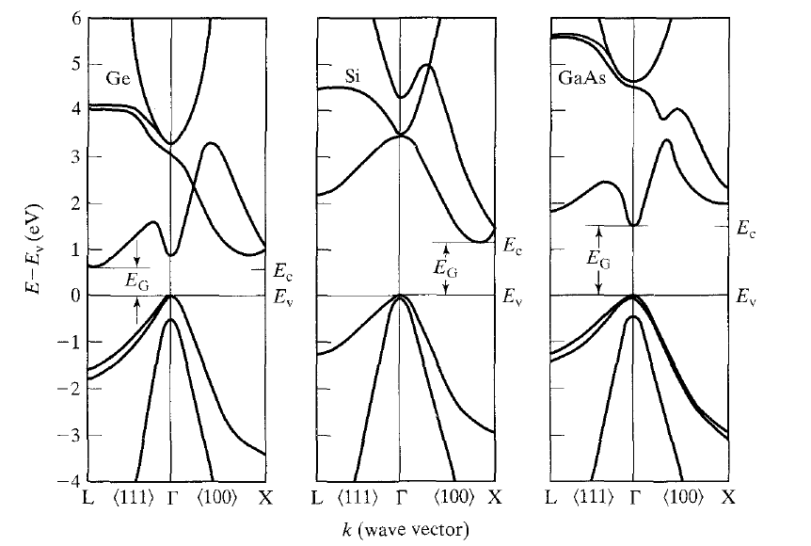
E-k diagrams
Plot only for +k along <100> and <111> directions
17/01/18
S. Lodha

Slide 19
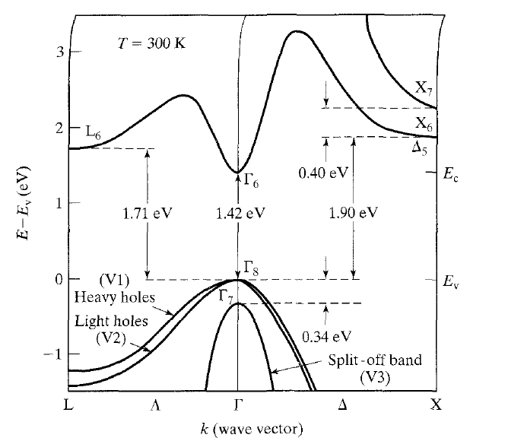
GaAs E-k diagram (detail)
Direct band-gap semiconductor
17/01/18
S. Lodha

Slide 20
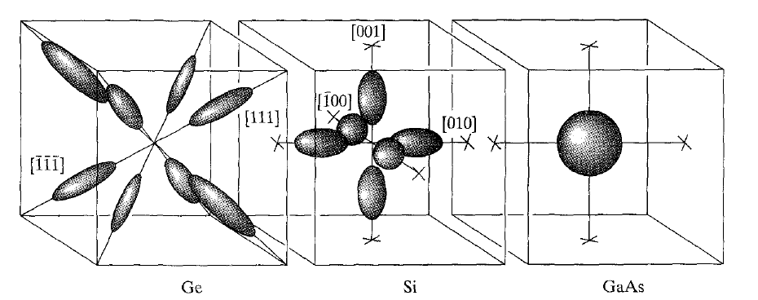
Constant energy surfaces (k-space)
Constant energy surfaces (all allowed k-values) for E=Ec in Ge, Si, GaAs
  Ge E=Ec along 8 equivalent <111> directions
  Si E=Ec along 6 equivalent <100> directions
  GaAs E=Ec at k=0, one constant energy surface
17/01/18
S. Lodha

Slide 21
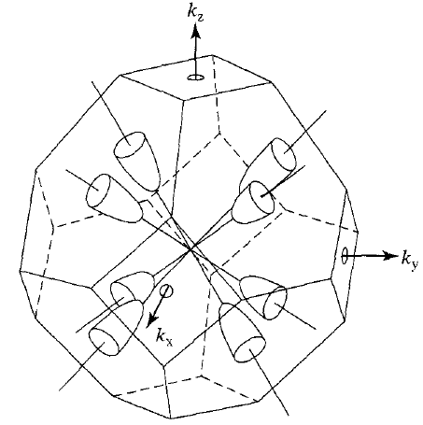
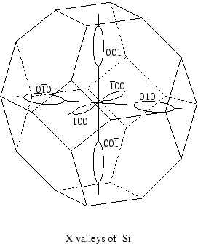
Constant energy surface (Ge,Si)
Eight L valleys of Ge
Ge conduction band minima occurs right at zone boundary along [111]
  Half of the Ge surfaces are in the first Brillouin zone
17/01/18
S. Lodha

Slide 22
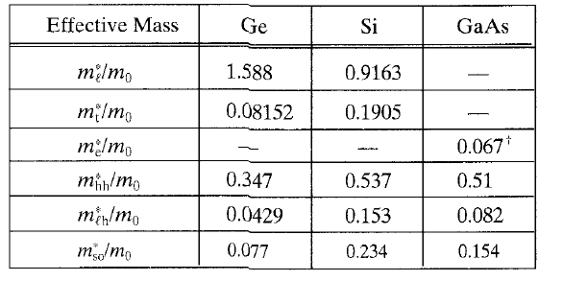
Effective mass (cyclotron resonance data)
Note that m_{l}>m_{t} for both Ge and Si
17/01/18
S. Lodha

Slide 23
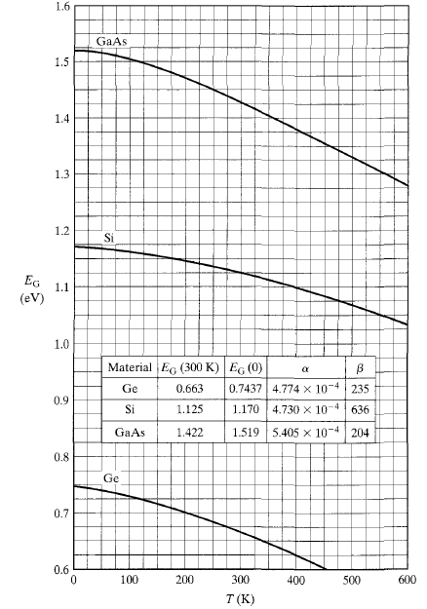
Band gap (vs T)
Eg decreases with increasing T
17/01/18
S. Lodha

Slide 24
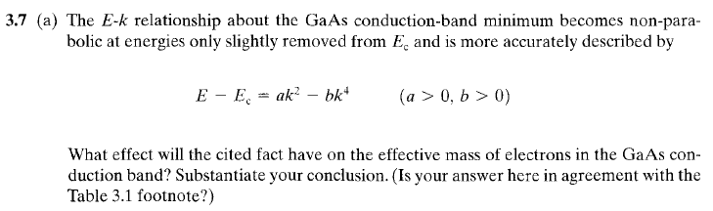
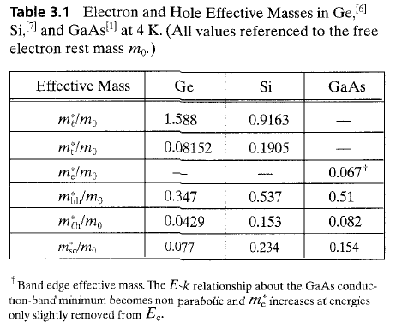
Problem 1
17/01/18
S. Lodha

Slide 25
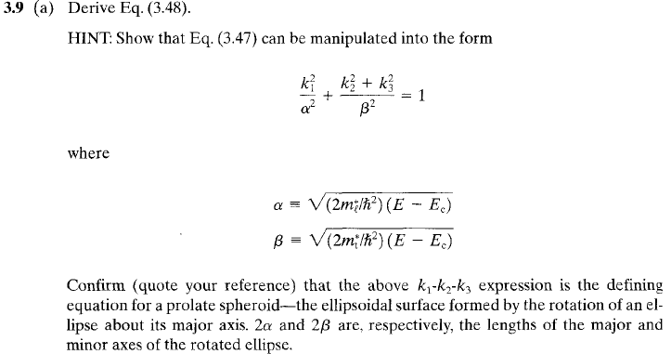
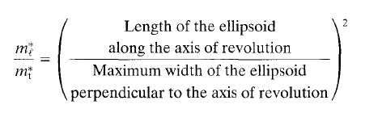

Problem 2
17/01/18
S. Lodha

Slide 26
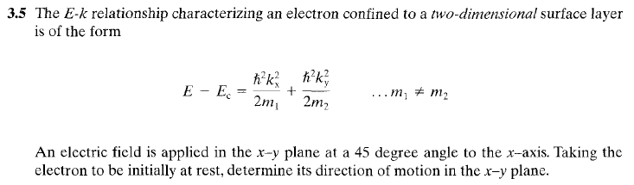
Problem 3
17/01/18
S. Lodha

Slide 27
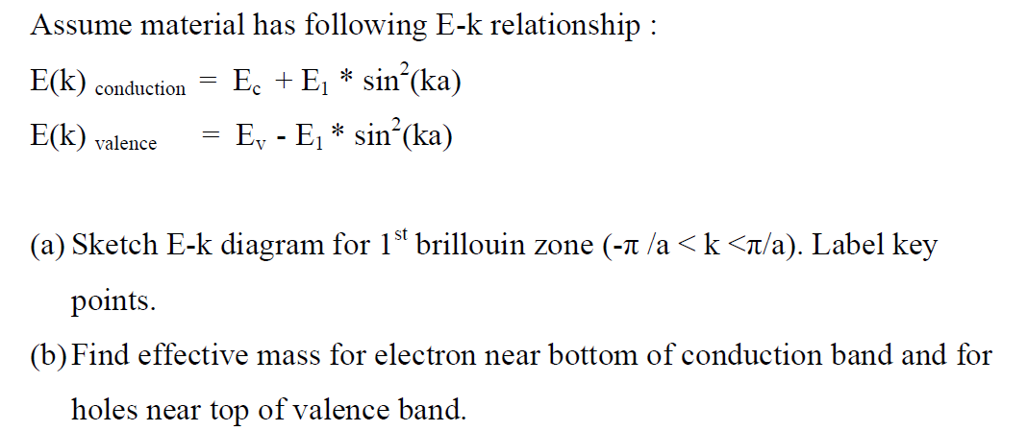
Problem 4
17/01/18
S. Lodha

Slide 28
Back up
17/01/18
S. Lodha

Slide 29
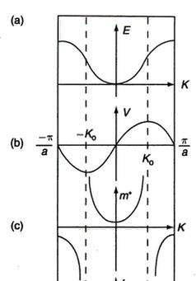
E-k
17/01/18
S. Lodha

Slide 30
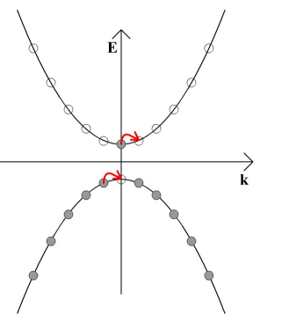
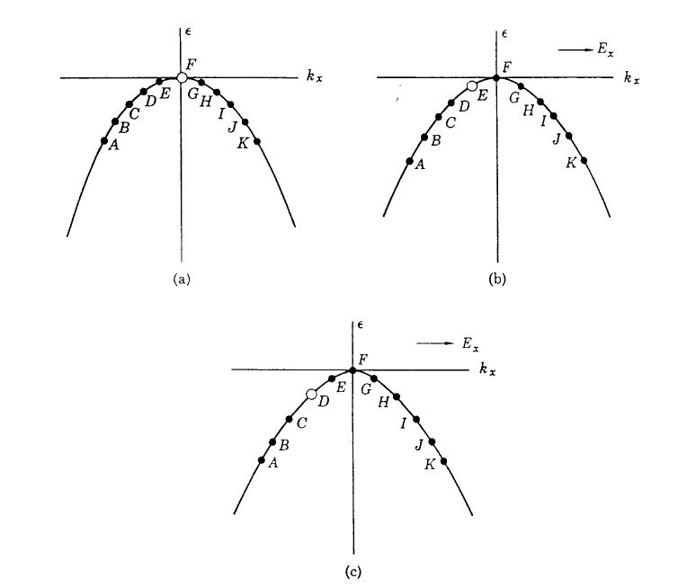
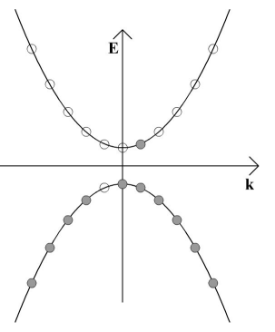
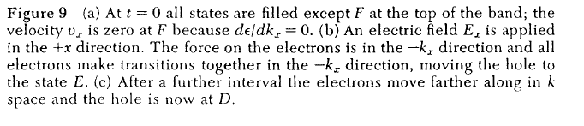
https://www.doitpoms.ac.uk/tlplib/semiconductors/charge_carriers.php
17/01/18
S. Lodha

Slide 31
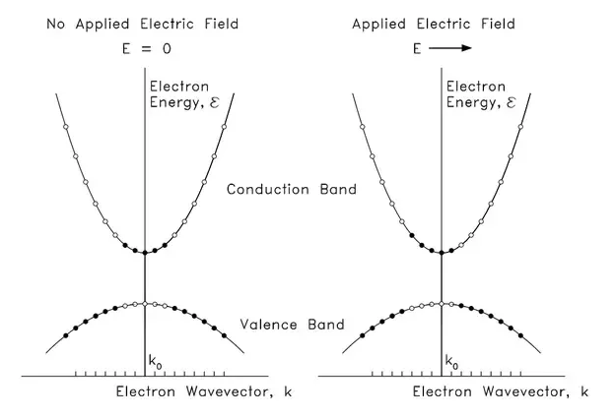
https://www.quora.com/Solid-state-physics-Why-do-holes-have-the-same-velocity-vector-as-electrons-and-not-reversed-Both-mathematical-and-visual-explanation-please
17/01/18
S. Lodha

Slide 32
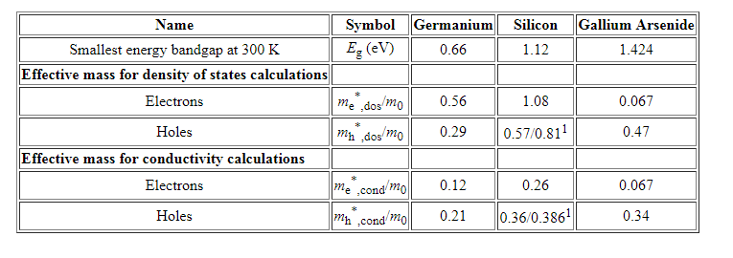
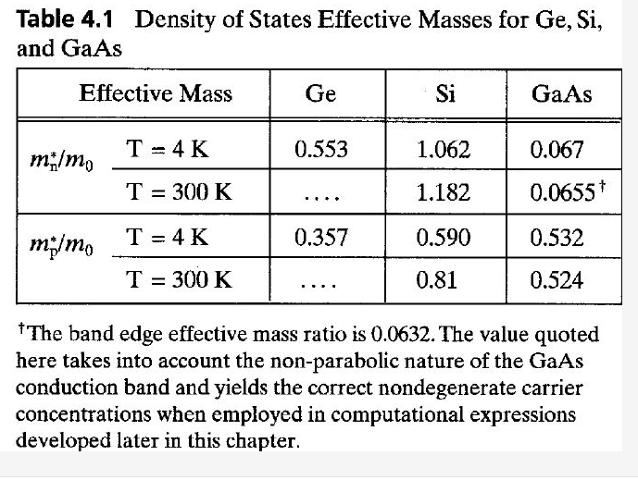
17/01/18
S. Lodha

Slide 33
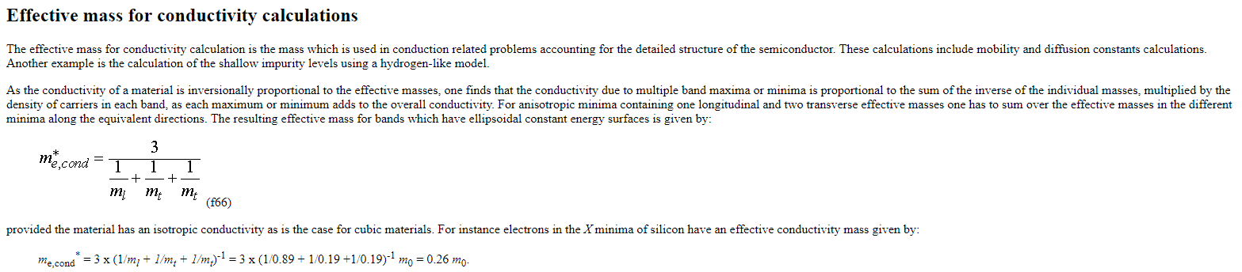
https://ecee.colorado.edu/~bart/book/effmass.htm#condmass
17/01/18
S. Lodha

